Slide 1
DAB103-001- GROUP PROJECT
Group Members
Pranav Jai Prasad - 0754284
Sneha Sabu - 0754791
Abhinav Sharma - 0753639
Harpreet Singh - 0753316

Slide 2
Agenda
Provide description of the dataset
Motivation for this Project
Perform Exploratory Data Analysis
Implement necessary ETL process
Produce Visualizations based on Research Questions
Conclusion
Future Scope of the Project

Slide 3
DATASET DESCRIPTION
The dataset that we are going to explore is a combination of the datasets of Top 5 Global Tech Organizations namely AMAZON, MICROSOFT, GOOGLE, APPLE and FACEBOOK. Each dataset represents the daily price action that includes open, high, low and close of Stock Price. It also gives us an idea of the volume of share transaction per day.
Data time frame - 1 Year [2019-03-04 to 2020-03-03]
Currency of Price data - In dollars [$]
ANALYSIS QUESTIONS
Q.1.Rank the Company names according to Annual Growth Percentage?
Q.2.Find the monthly trend of these companies based on $ value traded?
Q.3. Compare the risk of stock by organizations based on price fluctuation?
Q.4. Which company is preferred to be the best to invest according to the investors?

Slide 4
Motivation
It was when we had our first group meeting, that we all came to know that everybody was keenly interested and specific to take some business-related data set which would be more interesting and challenging to work on. As budding Data Analysts, and born in the age of technological developments and businesses rising, we planned to compare some of the market revenues of the Globally head Tech Organizations. We all are one way or the other subscribers of all of the organizations referred.
Another major factor that made us choose these company’s data sets are we have come beyond the discussion of some of these tech giants of Silicon Valley in our Artificial Intelligence subject such that it is said they were generating a large amount of revenues equal to that of those generated by three most populous automaker companies in Detroit. The major difference was that Tech’s employed less labor force. So we all were keen to explore more into it.

Slide 5
Exploratory Data Analysis

Slide 6
Exploratory Data Analysis
BASIC R COMMANDS
Importing all 5 different datasets for basic operations:
apple_dataset <- read_csv(here("data", "AAPL.csv"))
amazon_dataset <- read_csv(here("data","AMZN.csv"))
fb_dataset <- read_csv(here("data","FB.csv"))
google_dataset <- read_csv(here("data","GOOG.csv"))
mcrsft_dataset <- read_csv(here("data","MSFT.csv"))
Finding the sum of Volumes of each dataset separately to identify which has the highest Volume of shares.
volume_amazon<-sum(amazon_dataset$Volume)
volume_facebook<-sum(fb_dataset $Volume)
volume_google<-sum(google_dataset $Volume)
volume_microsoft<-sum(mcrsft_dataset $Volume)
volume_apple<-sum(apple_dataset $Volume)
Max_of_all<max(volume_apple,volume_amazon,volume_facebook,volume_google,volume_microsoft)

Slide 7
Doing the Mutate Function to add a separate column for Stock Name before combining all the dataset to one.
apple_dataset <- mutate(apple_dataset ,stockname=c(rep('AAPL',253)))
amazon_dataset <- mutate(amazon_dataset,stockname=c(rep('AMZN',253)))
fb_dataset <- mutate(fb_dataset,stockname=c(rep('FB',253)))
google_dataset <- mutate(google_dataset,stockname=c(rep('GOOG',253)))
mcrsft_dataset <- mutate(mcrsft_dataset,stockname=c(rep('MSFT',253)))
Now combining all the datasets together to form a single dataset.
final_data <- rbind(apple_dataset, amazon_dataset, fb_dataset, google_dataset, mcrsft_dataset)
Getting the number of rows and columns of the present dataset.
dim(final_data)
Identifying what type of variables are present in that dataset.
str(final_data)

Slide 8
Description of R commands
First we imported all the 5 different data sets.
Then we calculated which company has the highest volume of share transactions per day. Apple has the highest volume followed by Microsoft.
We added an additional column for Ticker Name of each stock and then combined all the dataset to a single one.
Familiarized the final dataset with some basic functions to see the dimensions and structure of the data set.
SL No. | Description | Values
1 | Number of Rows | 1265
2 | Number of Columns(after mutation) | 8
3 | Dimensions | Date, Stock Name
4 | Measures | Open, Close, High, Low, Adj Close, Volume

Slide 9
ETL PROCESSES
In R
Insert a column for Ticker Name(Stock Name).
Combined the 5 different dataset to a single one.
In Tableau
Insert a calculated column for Daily Average Price (Avg of the values of Open and Close)
Insert a calculated column for daily traded volume in dollars (Daily Avg Price*Volume)
Insert a calculated column for Normalized values of Daily Average of each stock.

Slide 10
Visualizations and Dashboards

Slide 11
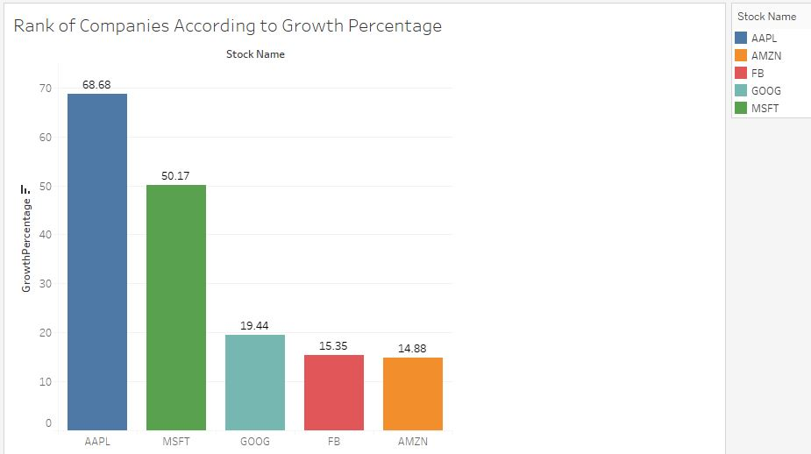
Q.1. Rank the Company names according to annual growth percentage?

Slide 12
A brief explanation of the Graph
Bar graphs are more helpful for analyzing more substantial variations in data amongst different groups.
In this graph, the names of companies are on the X-axis and the Percentage of Companies Growth are on the Y-axis as labels.
This graph depicts the growth of each company from March 2019 to March 2020. As seen in the graph the rank goes as Apple holding the first position with a growth of 68.68%, followed by Microsoft at 50.17%, then by Google at 19.44%, Facebook with 15.35%, and Amazon with 14.88%. The stock price of Amazon is 10 times greater than Apple from the data, but still ranks the least in growth percentage as apple is having a greater number of volume of shares transactions than Amazon.

Slide 13
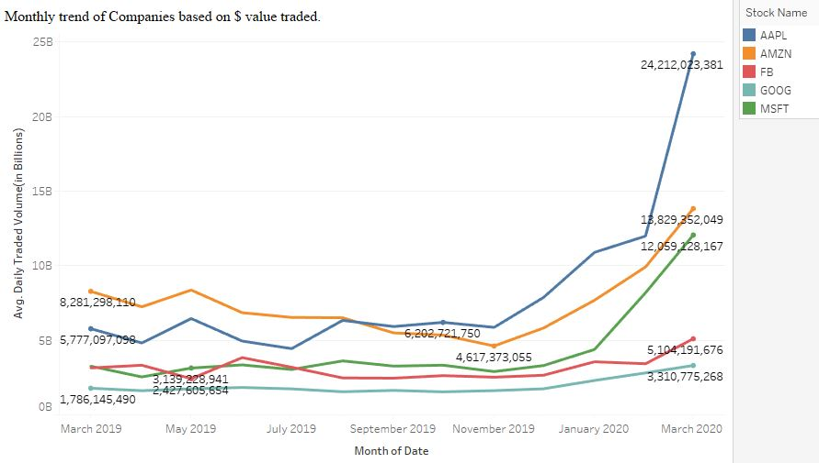
Q.2. Find the monthly trend of these companies based on $ value traded?

Slide 14
A brief explanation of the Graph
The best graph for a time series visualization is the line graph.
This graph gives us an overview of the monthly trend of each company based on the dollar value traded. The labels on the Y-axis is the average of the Daily Traded Volume and a time period of one year on the X-axis.
It is apparent from the graph that Amazon is leading at over 8 billion over all the companies at the initial date of March 2019, which was followed by Apple at over 5.7 billion. Facebook and Microsoft tailgated at nearly same along with Google which was the lowest at over 1.7 billion. It was progressing the same till around the start of May, the traded volume for Facebook declined under Microsoft to around 2.4 Billion when Microsoft headed to 3 billion and then suddenly Facebook yielded up over the same and the graph moved so on. By start of September to November, Apple started to gross more than Amazon to a value of 6.2 billion when Amazon’s trade reduced to 4.6 billion. Finally, in the end, it was Apple that possessed the highest value of around 24 billion leading Amazon and pushing it to the second at 18 billion, but initially traded was high for Amazon. Google always possessed the lowest dollar value traded in the group.

Slide 15
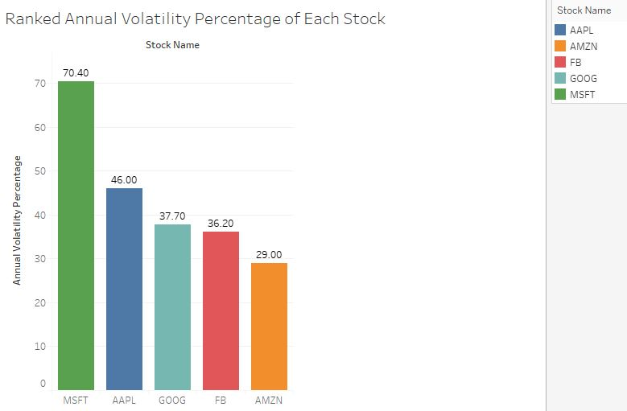
Q.3. Compare the risk of stock by organizations based on price fluctuation?

Slide 16
A brief explanation of the Graph
Bar graphs are more helpful for analyzing more substantial variations in data amongst different groups.
The above graph represents the Annual Volatility of each Stock under consideration and ranked in the descending order.
As the volatility increases the risk of the stock increases due to the major price fluctuation. The Microsoft is having the highest volatility of 70.4%, Apple with 46%, Google with 37.70%, Facebook with 36.20%, Amazon with 29%. The least price fluctuation is for Amazon possessing least risk for stock and Google ranges in the middle of all these five companies.

Slide 17
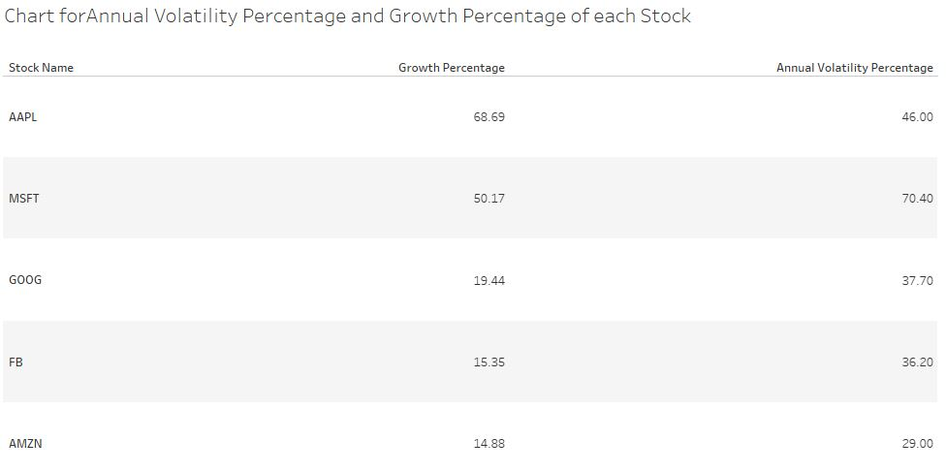
Q.4. . Which company is preferred to be the best to invest according to the investors?

Slide 18
A brief explanation of the Graph
This data table could explain the details in a succinct way since we have to compare between the Growth Percentage and Volatility Percentage of each stock.
This chart above gives the corresponding value of growth percentage and the volatility percentage of each stock respectively. The investment mainly depends on the type of investors and their period of investment.
There are different types of investors in Stock Marketing like Long term Investors, Swing Traders, and Day Traders. The Long-term investors invest for a long period from 6 months and more. Whereas the Swing Traders invest in a stock for a week and day traders do it for a day. Long term investors prefer high Growth Percentage stock with Less Volatility. Swing Traders considers a high Growth Percentage with Medium Volatility. The day traders prefer highly volatile stock since they account for a single day and not keep the growth factor under consideration.
So, for some long-term investors the company Apple seems to be the best investment since it has the highest growth percentage. The day traders prefer to invest in Microsoft since it has the highest Volatility. Swing Traders may shortlist both Apple and Microsoft to invest. Out of that two, Apple will be chosen because it has a high growth percentage and less volatility than the other.

Slide 19
Conclusions
This project was mainly based on the comparison of the Shares of Stock given out by the Globally top 5 Tech Companies in the world. The Stock market also known as the equity market or share market is that in which buyers and sellers come together to get shares of publicly owned companies. They can participate in the business successes of each company's share they own. It is mostly done by electronically traded platforms.
In this project, we have selected 5 tech companies and have analyzed them to understand and get some perspicacity on how good each stock is and which shows the highest growth and lowest volatility. The volatility of stock gives the variation of the trading price of each stock over a period of times. In this modern era of businesses and technological development, it is quite good to hold a mark in industry electronically and people must indulge into the trading sector so that they can earn profits through the capital gains of those companies. This importance has made us do the project by which we were able to learn more about the investment type and type of investors and to extract out the key factors to predict about investing in which company.

Slide 20
Future Work
As a work for the future, we could have found the quarter percentage growth which would determine the good investment company for quarterly investors.
We could predict the future trend in price action based on historic data and provide an investment suggestion for high risk-takers and low risk-takers along with the expected increase in value.
We could also emphasize the ideal proportion of investment in each of these shares that will yield maximum return in 1 year.
We could explore more if they had given the data of the history of returns of financial gains each shareholder has attained for the period they have invested.

